Slide 1



Project Presentation on Full Stack Developer
Guided By
Satheeshwaran D
By
Dhinesh Saravanan

Slide 2
What Is Mean By FSD ?
Front-end Developer
Back-end Developer
Full Stack Developer

Slide 3
Types Of Full Stack Developer :
MEAN Stack: MongoDB, Express, AngularJS (and) Node.js.
MERN Stack: MongoDB, Express, ReactJS (and) Node.js.

Slide 4
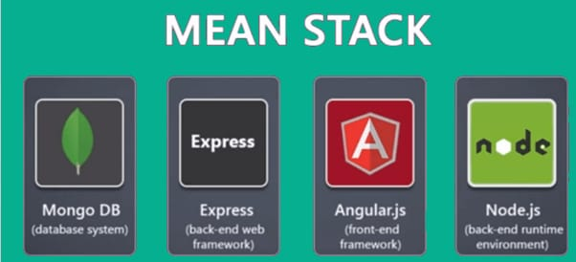
Mean Stack :

Slide 5


Slide 6
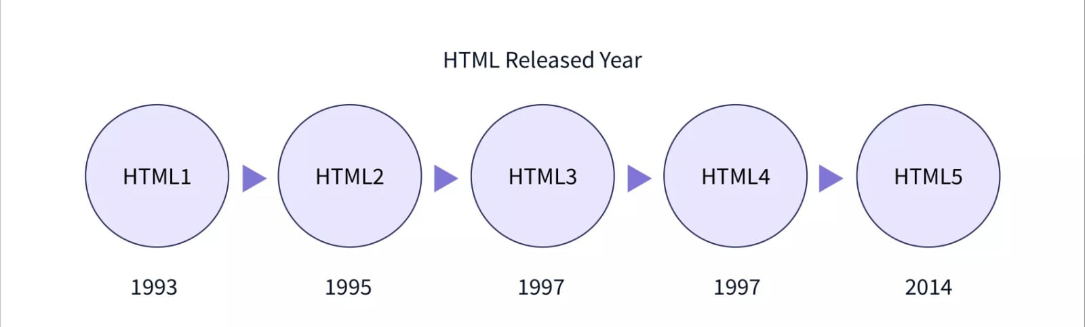
HTML :
Hyper Text Markup Language.
The standard markup language used to create and design webpages.
Version Of HTML:

Slide 7
CSS :
Cascading Style Sheets.
Responsible for web pages.
It controls the colors, fonts, and layouts of your website elements.
This style sheet language also allows you to add effects or animations to your website.

Slide 8
Java Script :
JavaScript is a scripting language for creating dynamic web page content.
It creates elements for improving site visitors' interaction with web pages, such as dropdown menus, animated graphics, and dynamic background colors.

Slide 9
Bootstrap :
Bootstrap is a free front-end framework, with the purpose to make web development faster and easier.
It also includes HTML and CSS-based design templates for forms, typography, buttons, navigation, tables, modals, image carousels, and many other components along with other optional JavaScript plugins.

Slide 10
The Project Title
Native District Website Using FSD

Slide 11
Navigation Bar :
<nav> Content </nav>

Slide 12
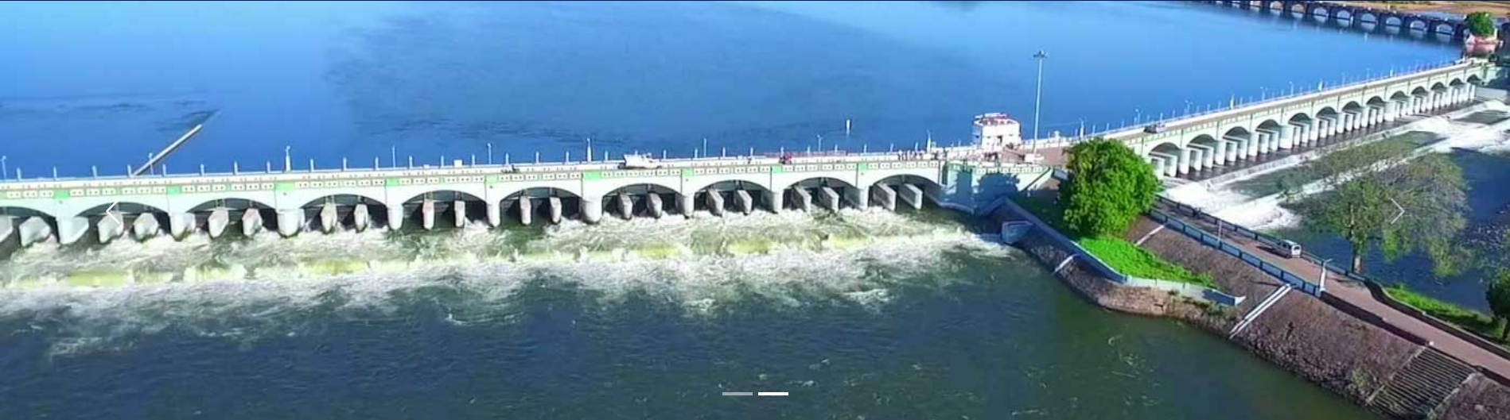
Carousel :
<div id="demo" class="carousel slide" data-bs-ride="carousel"> Content </div>
Tag For: <button> Content </button>

Slide 13
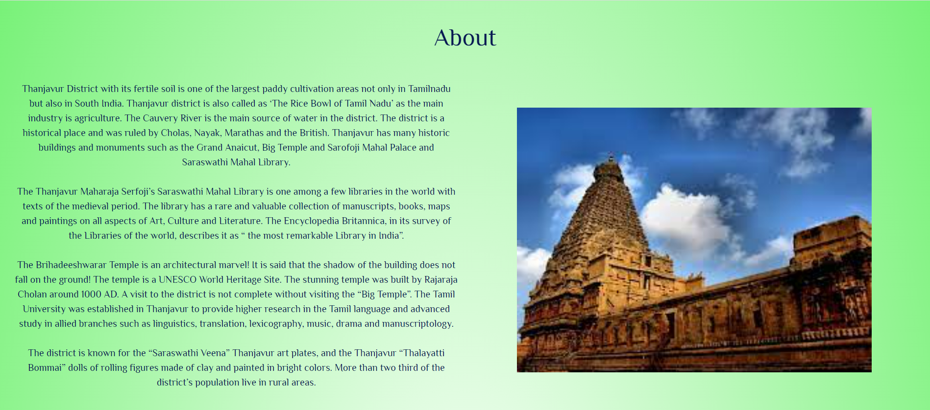
ABout :
<div class="container-fluid"> Content </div>
Col 1
Col 2
Row

Slide 14
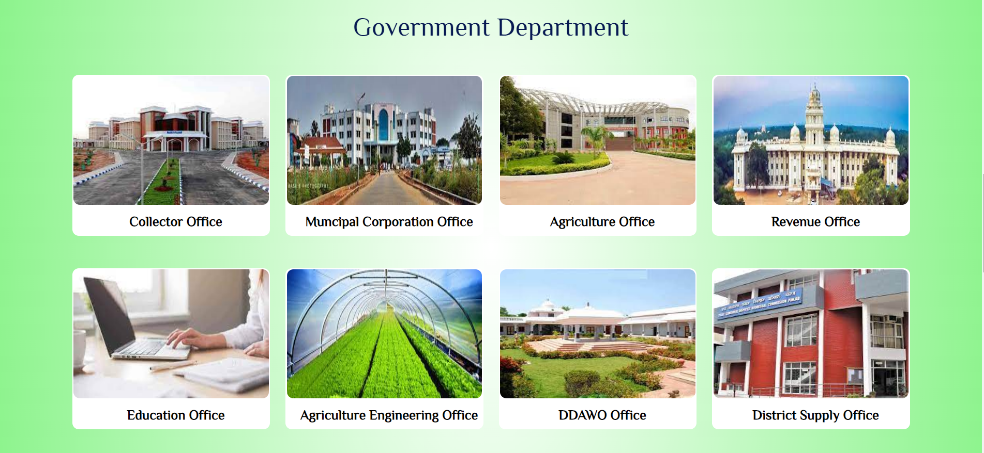
Government Department :
<div class="container"> Content </div>
Col-3
Col-3
Col-3
Col-3
<div class="row">
</div>
Col-3
Col-3
Col-3
Col-3
<div class="row">
</div>

Slide 15
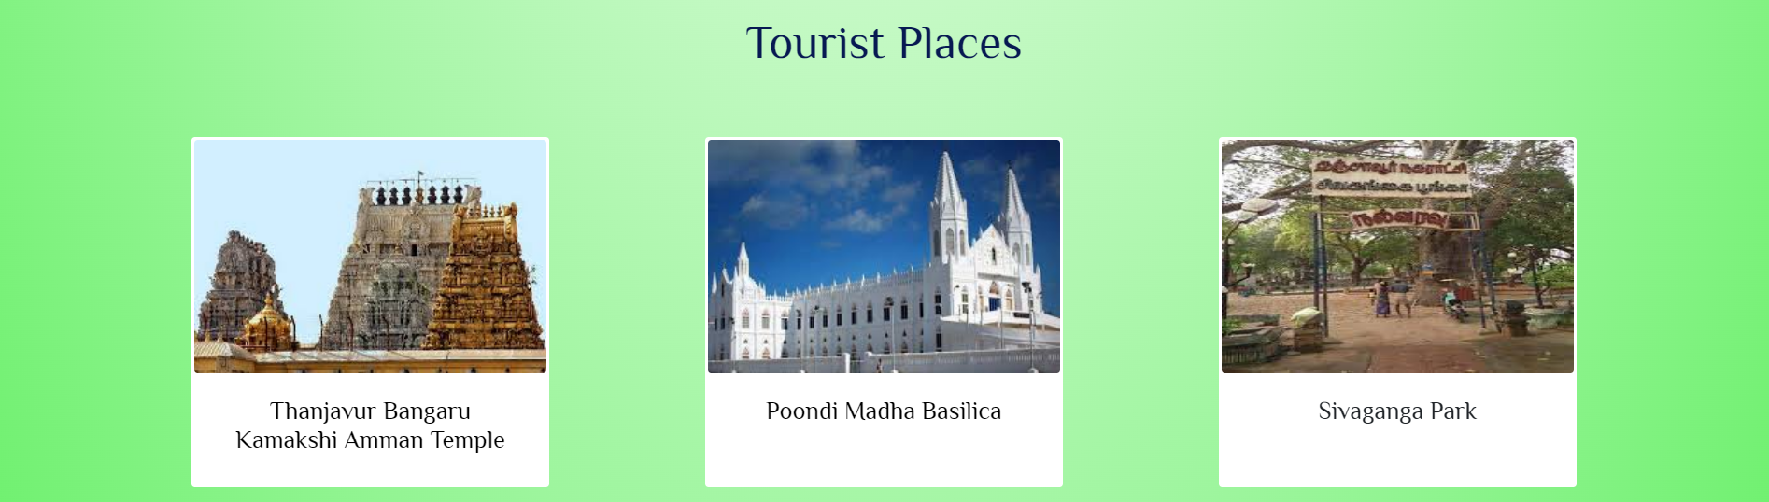
Tourist Places :
<div class="carousel-inner">
<div class="carousel-item active">
<div class="container”>
Col-3
Col-3
Col-3
<div class="row">
</div>
</div>
</div>
Continue By Next Page

Slide 16
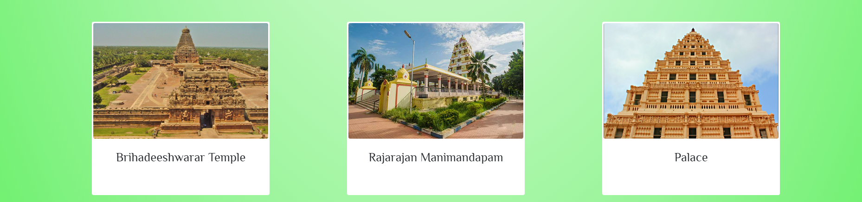
Tourist Places :
<div class="carousel-inner">
<div class="carousel-item">
<div class="container”>
Col-3
Col-3
Col-3
<div class="row">
</div>
</div>
</div>
</div>

Slide 17
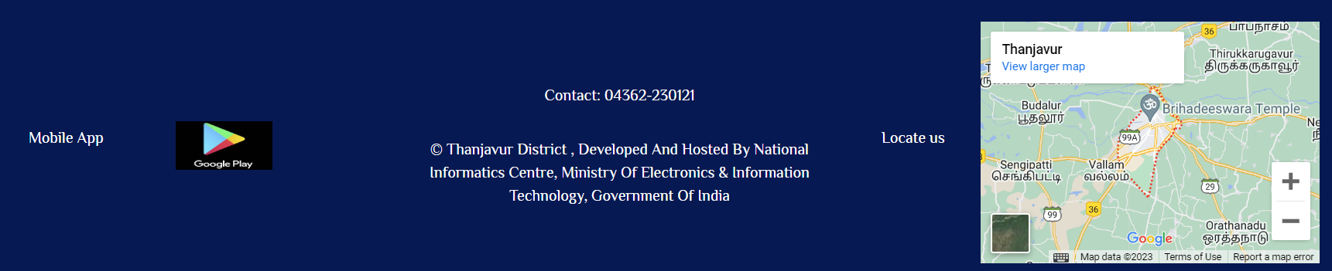
Contact :
<div class=" p-4 bg-dark text-white text-center“>
<div class="container-fluid">
Col
Col
Col
Col
Col
<div class="row">
</div>
</div>
</div>

Slide 18
THANK YOU

